Slide 1

Developing SaltStack
Nicole Thomas, SaltStack QA Engineer
Nitin Madhok, Clemson University Systems Developer
Follow us on GitHub @rallytime and @nmadhok
#SaltConf15

Slide 2

Welcome
What we’ll cover...
Setting up your Development Environment
Salt’s Branching Strategy
Creating An Issue
Finding and Fixing Issues

Slide 3

Set up your Development Environment
Installing packages, Cloning repository, Creating isolated python environment etc.
Notes:
Nitin

Slide 4
Resources
Helpful links to be used during this demo
Setting up git:
https://help.github.com/articles/set-up-git/
Generating SSH Keys
https://help.github.com/articles/generating-ssh-keys/
Installing Salt for Development
http://docs.saltstack.com/en/latest/topics/development/hacking.html
Notes:
Nitin

Slide 5
Branching Strategy
Notes:
Nicole

Slide 6

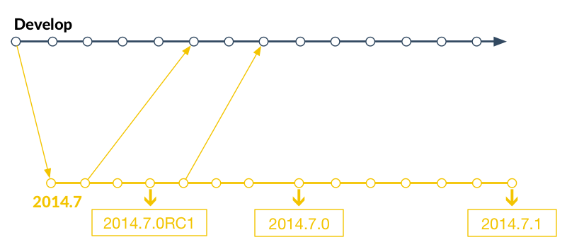
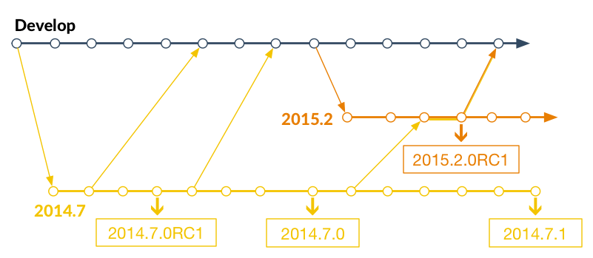
Salt’s Branching Strategy
Features, Bugfixes, and Forward Merges
New Features
Major Refactors
Bugfixes
Notes:
Nicole

Slide 7
Creating an Issue
Have a great idea for a new feature?
Found a bug?
Notes:
Nicole

Slide 8
Creating Issues
Best Practices for creating new issues
Does the issue already exist?
Yes? - Document your findings there.
If not, good bug reports include:
Descriptive Title
Detailed report of the problem
Steps to reproduce the issue
Versions Report:
salt --versions-report
salt <minion> test.versions_report
Notes:
Nicole

Slide 9
Finding and Fixing Issues
Learn how to find existing issues and submit a Pull Request to fix them.
Notes:
Nitin

Slide 10
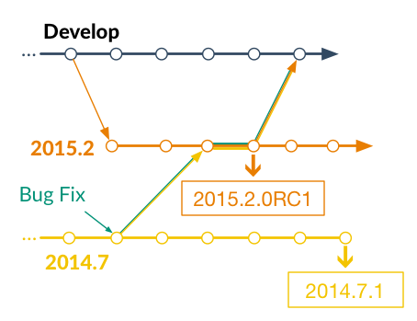
Branching Strategy: Bugfix
Bugfix on 2014.7 merges forward
Notes:
Nicole

Slide 11
Contributing: Preparation
Find the correct branch and prepare for commits.
New Feature? Large Refactor?
Develop!
Bugfix?
Locate Correct Bugfix Branch
2014.7 or 2015.2
Pull fresh copy down of the correct branch
Create new, local branch
"fix_25381" or "linode_cloud_tests"
Notes:
Nicole

Slide 12
Contributing: Work Your Magic
Make your changes and commit them.
Only fix "one story"
Commit changes to local branch
Auto-Close Issues
"Fixes #25381"
Must go in the commit message
Push local branch to your GitHub repository
Create Pull Request
Notes:
Nicole

Slide 13
Contributing: Pull Requests
Submit your changes to Salt!
Descriptive PR Title
Message provides more details
Reference issue number
Submit PR against the correct branch
Defaults to develop
Keep an eye on test results
Fix any issues
New commits == new testrun
Notes:
Nicole

Slide 14
Resources
Helpful Salt and GitHub Documentation
Salt Documentation:
http://docs.saltstack.com
Contributing Documentation:
http://docs.saltstack.com/en/latest/topics/development/contributing.html
Installation for Developers Documentation:
http://docs.saltstack.com/en/latest/topics/development/hacking.html
Testing Documentation:
http://docs.saltstack.com/en/latest/topics/development/tests/index.html
GitHub:
Forking a repo: https://help.github.com/articles/fork-a-repo/
Submitting a PR: https://help.github.com/articles/using-pull-requests/

Slide 15
Thank you
Please provide session feedback in the SaltConf15 mobile app
#SaltConf15

